Slide 1
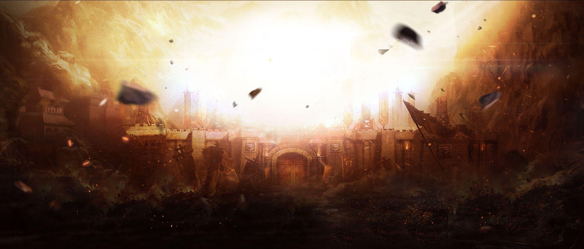
Ukrainian - russian war
Sentiment Analysis

Slide 2
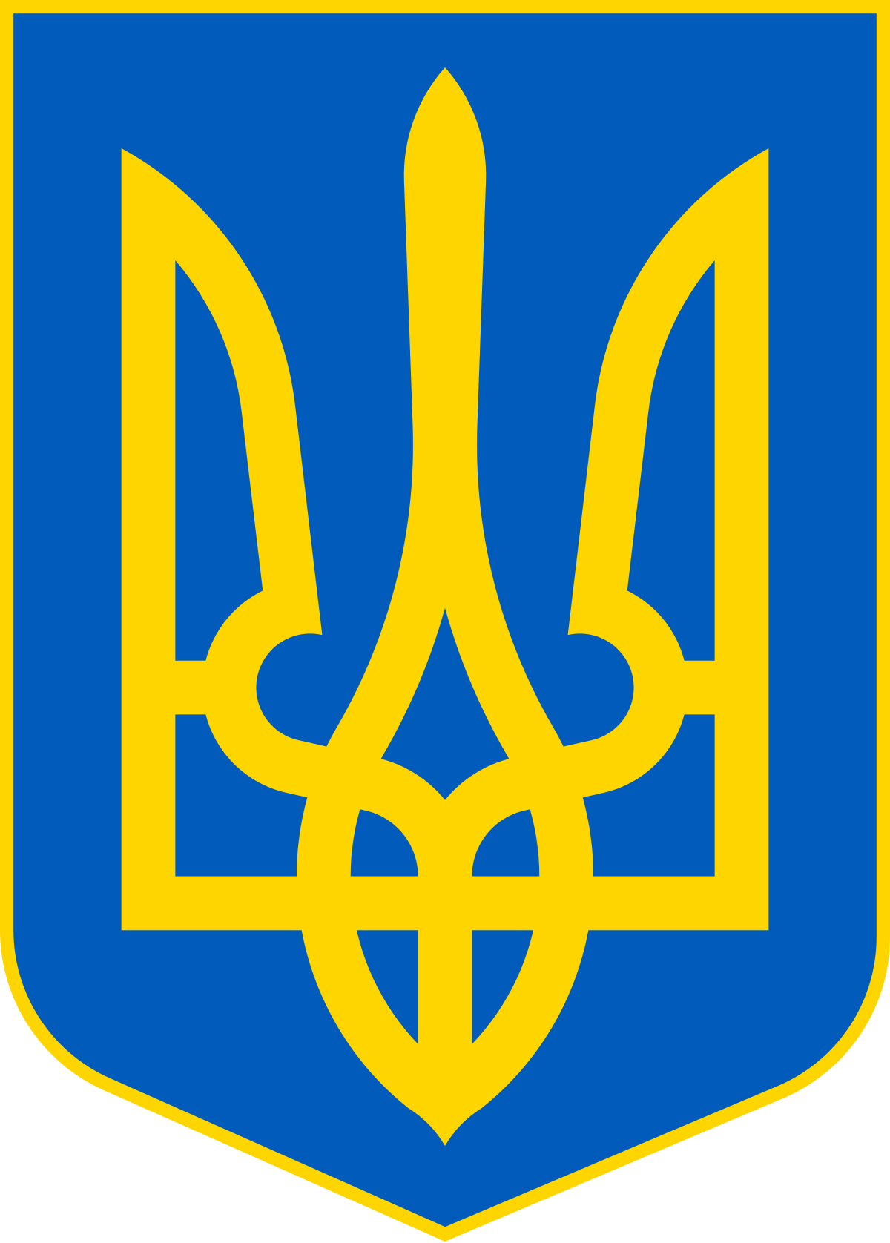
February 24, 2022. This date changed everything in my life. As I was finishing up my day here in the US, my parents, brother, sister, my whole family and friends back in Ukraine were woken up by explosions and missiles of russian army. No one could have imagined that russians will bomb Ukraine in 2022, right in the middle of Europe. My country is fighting hard, the war is taking away lives of brave Ukrainians who protect their land and families. My friends and family are on the battlefield now. I am doing this project to see how people around the world react to this war. Please see my discovery.

Slide 3
The goal of this project was to analyze people's reaction on the biggest war in Europe since World War 2 using Natural Language Processing.
Questions that I answered:
What are the languages of the tweets?
Origin of the tweets (from what countries)?
What is the public sentiment in the Twitter about the ongoing conflict?
NEGATIVE vs POSITIVE sentiment?

Slide 4
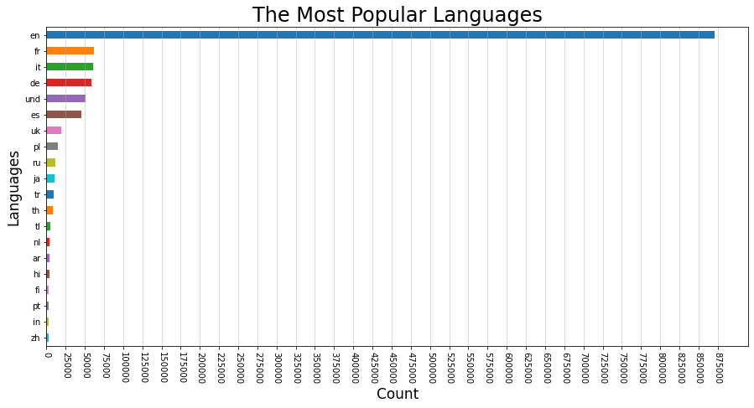
Out of all the languages the most tweets were written in English language. It may not be a surprising discovery, as English is one of the most popular spoken languages in the world.

Slide 5
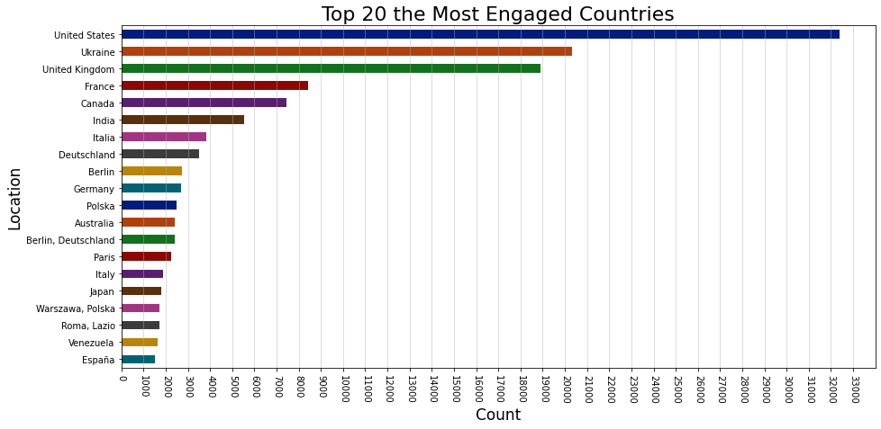
Biggest quantity of tweets were tweeted from people in the United States, which shows that US people are the most engaged in conversations about the ongoing wars in the world.

Slide 6
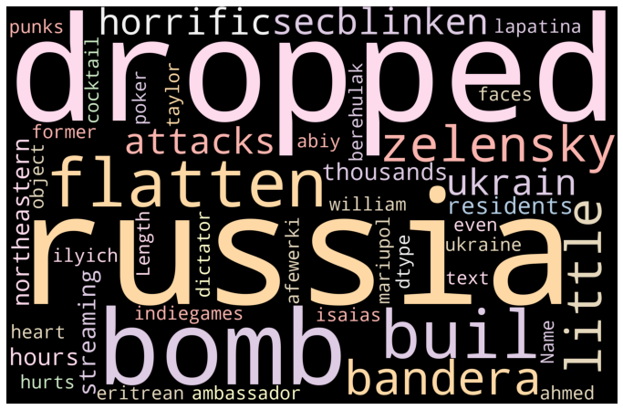
This WordCloud plot showing us that words 'russia' 'dropped' 'bomb' the most used (repeated) words in data set from tweets about war.
These words tell us the general idea of what people have been talking about in Twitter.

Slide 7
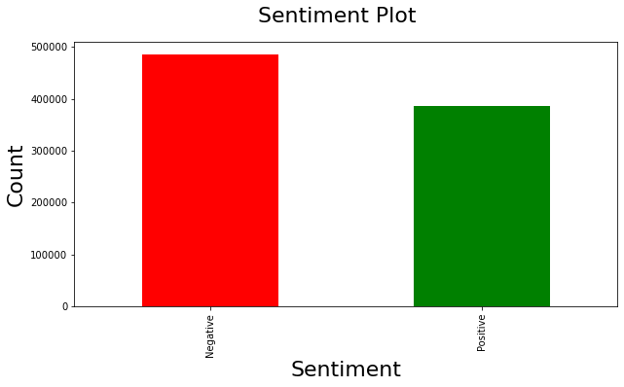
As we can see, most of the people were negative about the war.
This or similar approach can be useful for business to get reaction on certain product or service from customer reviews.

Slide 8
Takeaways from Ukraine - russia war tweets
Ukraine russia war is the biggest war that is taking place in the center of Europe after WW2. With the internet working all over the world, media streaming the news right from the war zone, it was important to discover what kind of reaction are we seeing from the public all over the world.
We found out that english speaking people (in particular in the US) are the most engaged in this conversation. Because of the extraordinary bravery of Ukrainian people we see a lot of positive comments on twitter about the war, but as expected during the war - the leading is a negative sentiment in the conversation.

